Slide 1
MindLLM: A Subject-Agnostic and Versatile Model for fMRI-to-Text Decoding

Slide 2
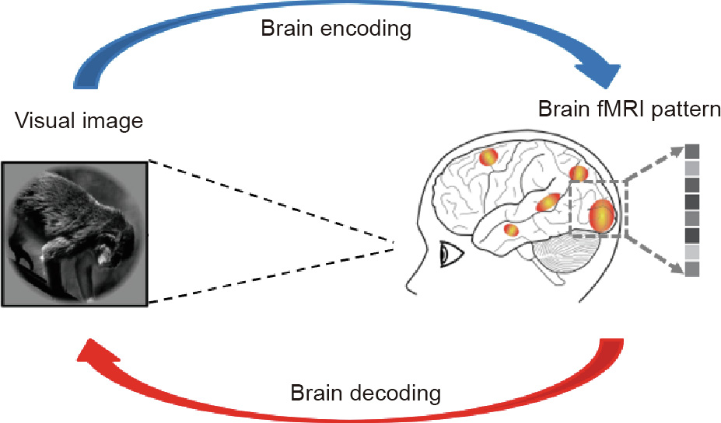
Encoding vs Decoding in Neuroscience
Encoding: How is the stimulus represented in the brain?
Decoding: Can we reconstruct the stimulus, given the brain response?
Changde Du, Jinpeng Li, Lijie Huang, Huiguang He. Brain Encoding and Decoding in fMRI with Bidirectional Deep Generative Models. Science Direct 2019.

Slide 3
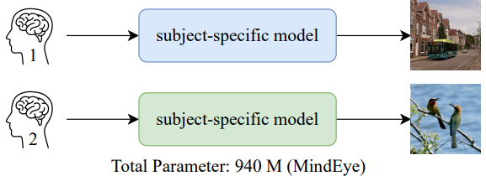
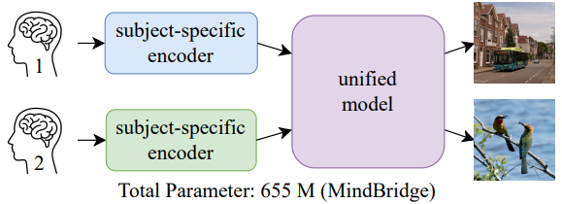
Decoding: training independent models per participant
MindEye
MindBridge
These methods greatly limit the generalization of the model with little scalability and struggle to capture cross-subject commonalities.

Slide 4
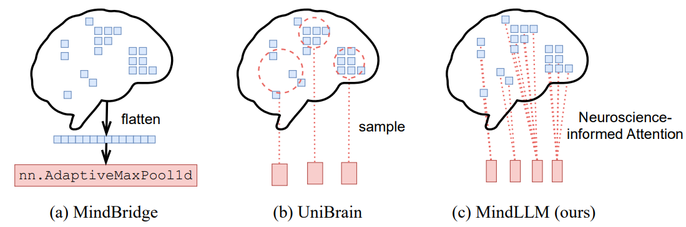
Decoding: cross-subject brain decoding
Pooling-based
Sample-based
All voxels
MindLLM incorporates both spatial information and neuroscientific priors of voxels, thereby significantly enhancing prediction accuracy

Slide 5
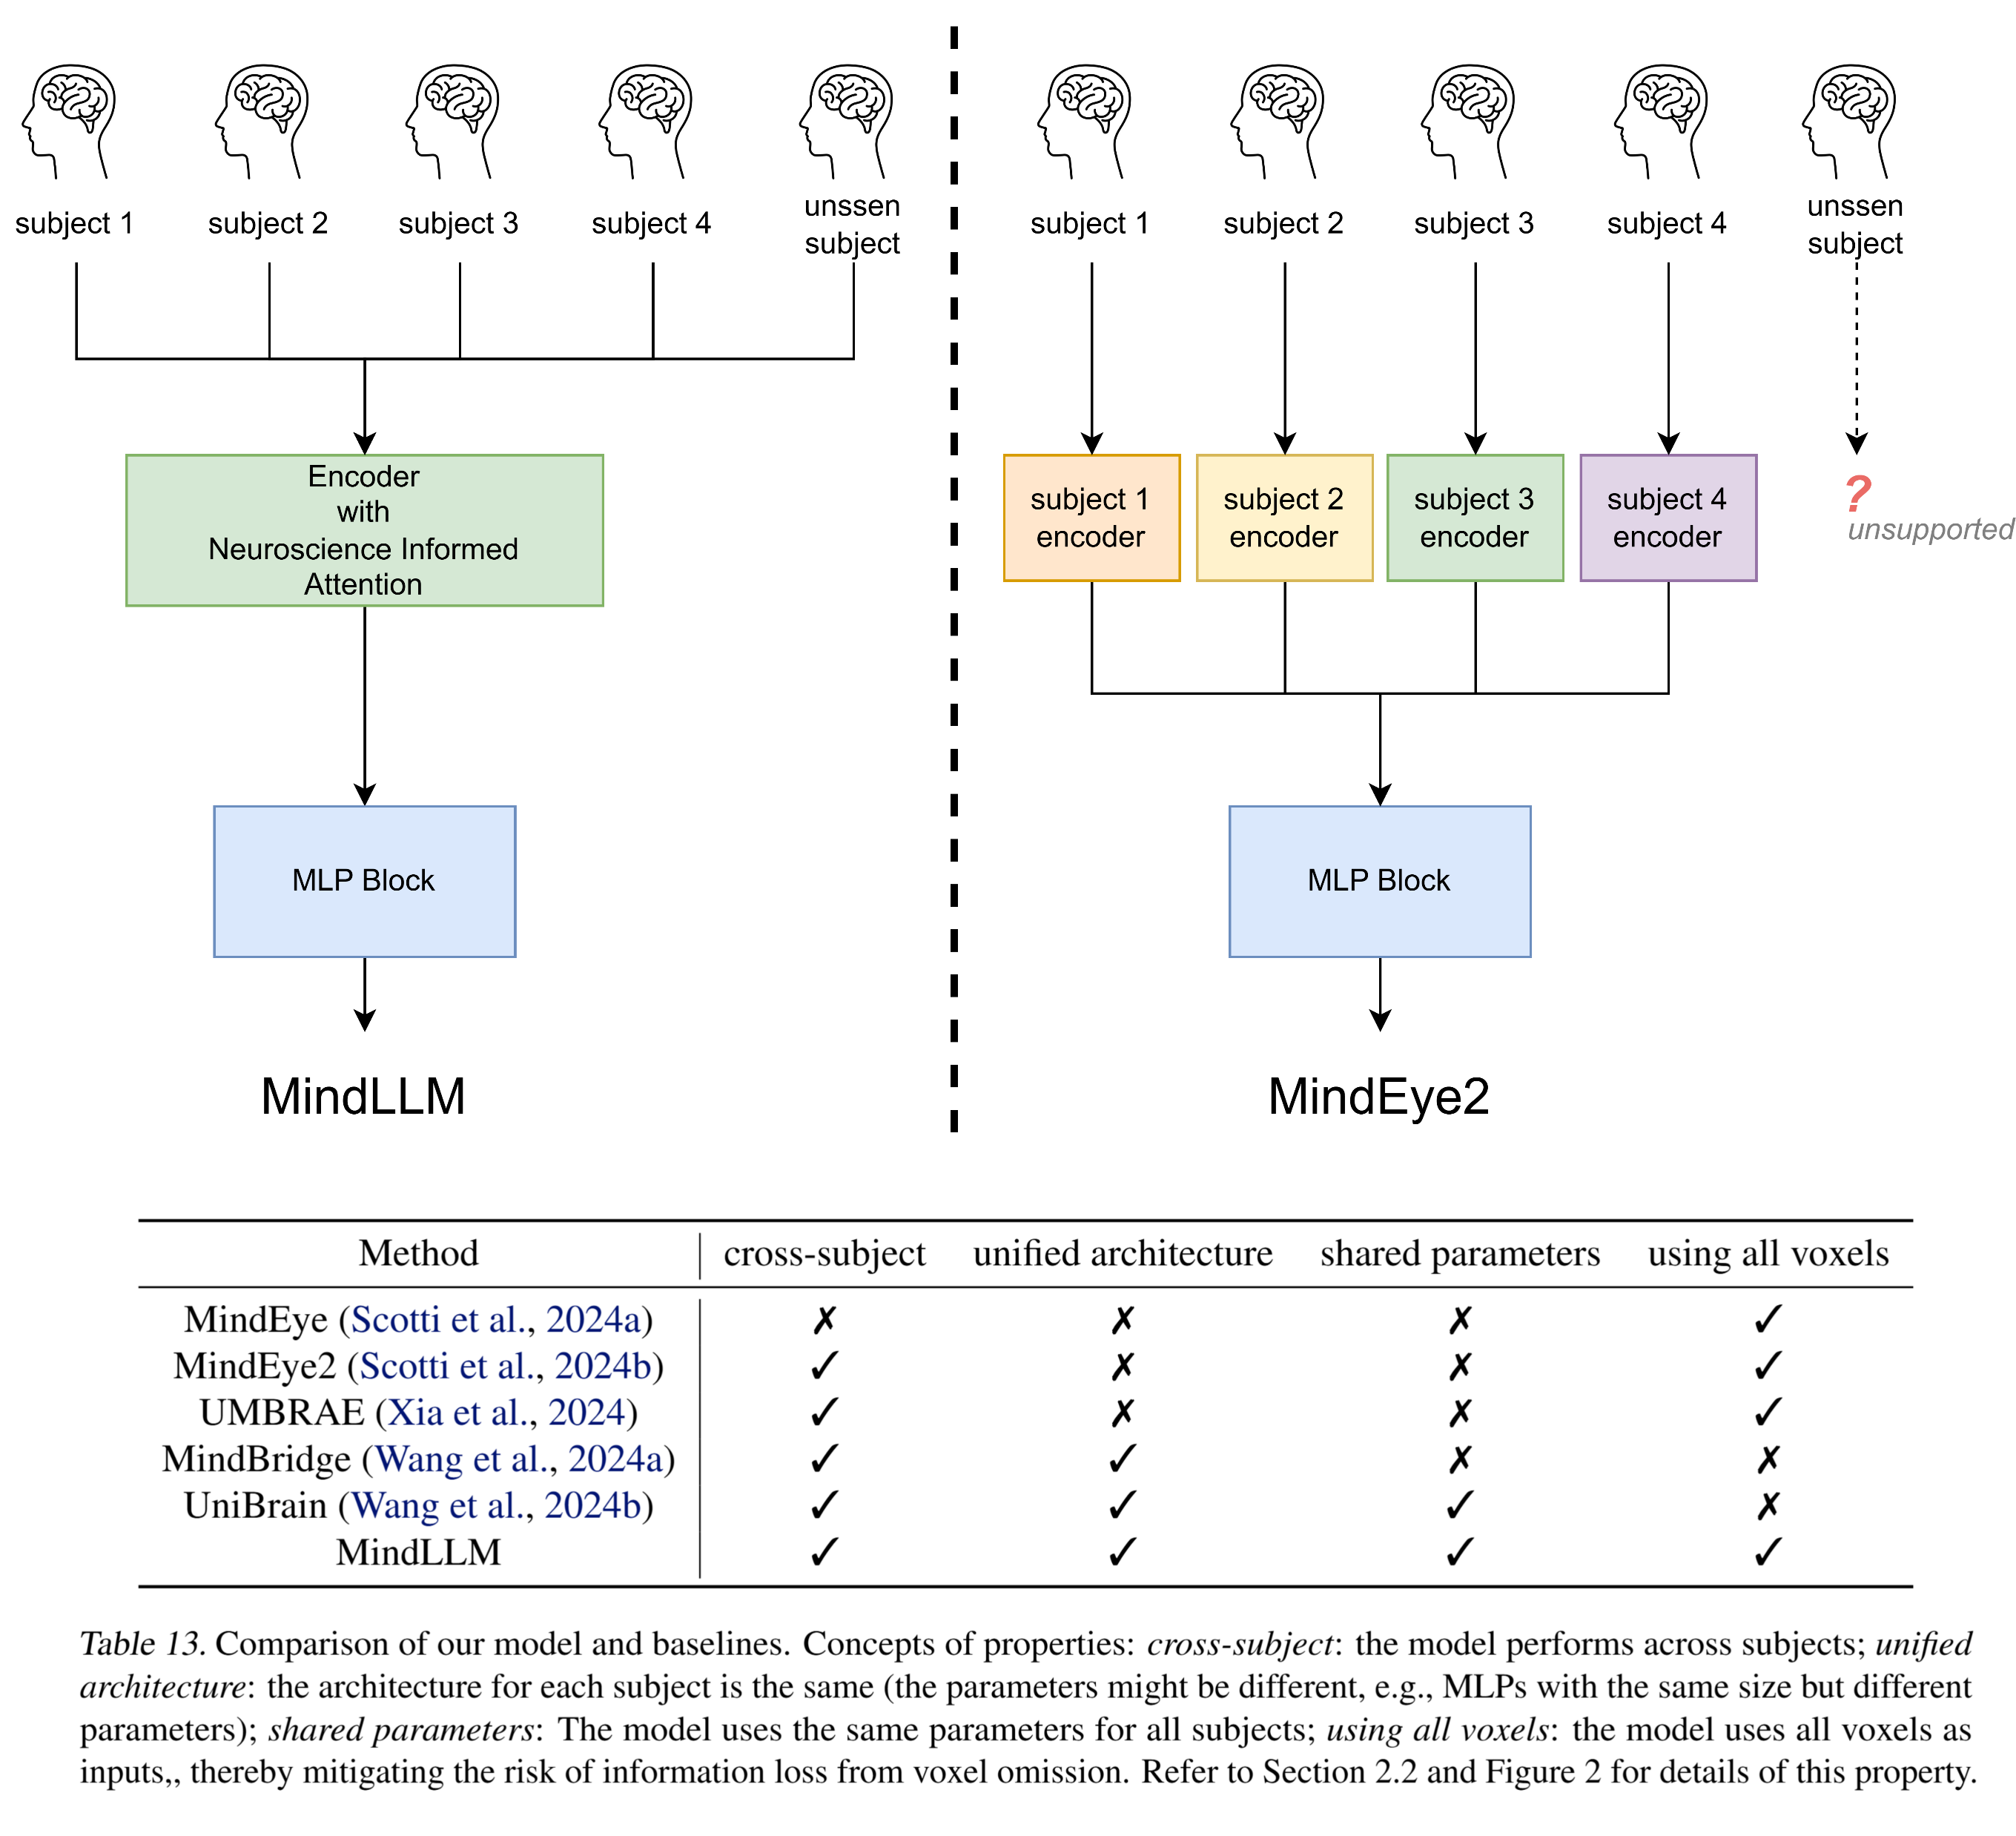
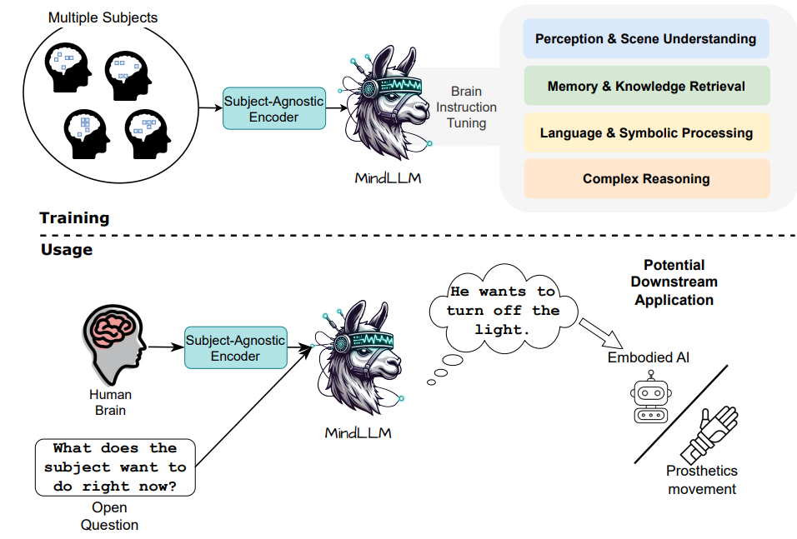
MindLLM: subject-agnostic fMRI encoder
Notes:
These language models are trained to [Keep clicking]
predict missing words over millions of text documents.

Slide 6

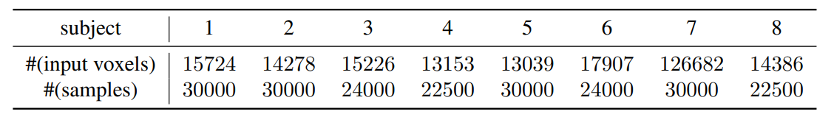
Dataset details
Brain: fMRI recordings from NSD dataset
Passively watching natural scene images
N=8

Slide 7
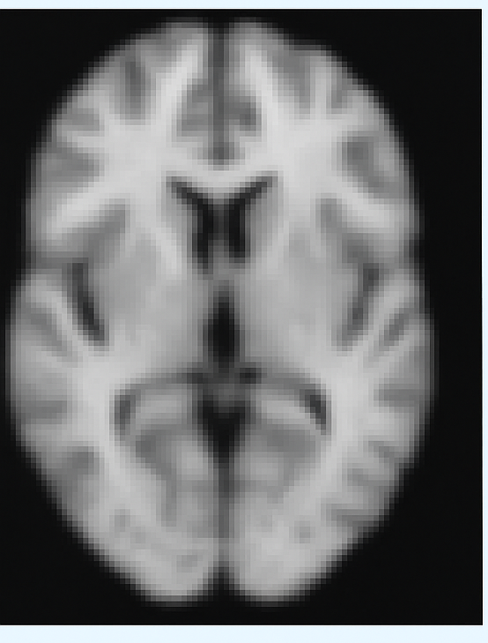
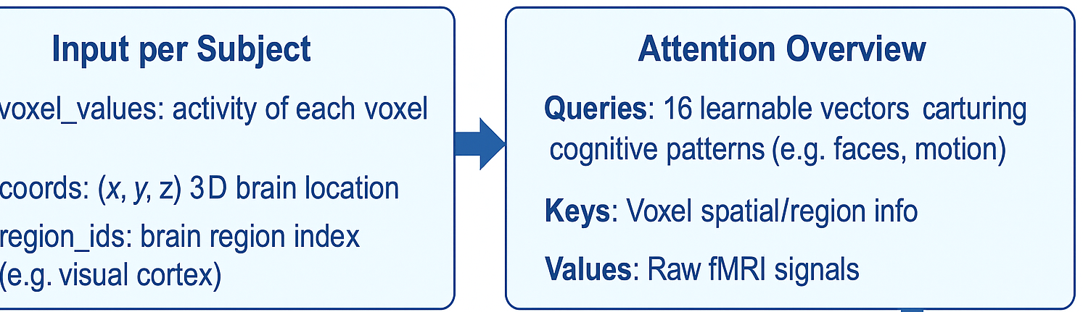
Methodological details
fMRI Encoder:
Each subject with variable number of voxels (ranging from 12,682 to 17,907)
Use a neuroscience-informed attention mechanism
Queries: Learnable
Keys: Brain region + voxel position
Values: fMRI signals (neural activity)

Slide 8
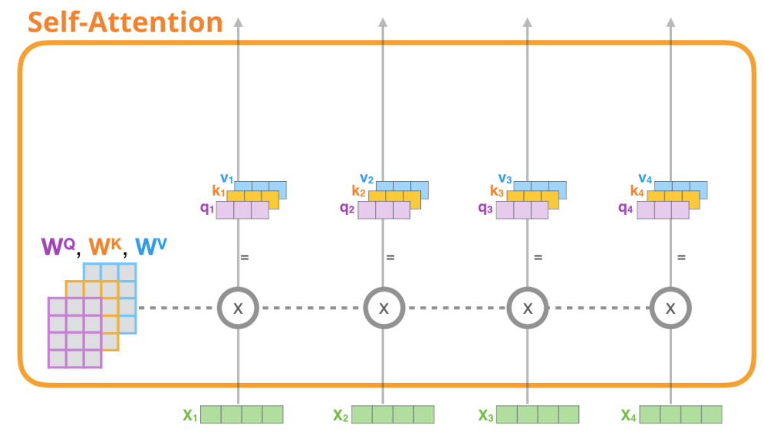
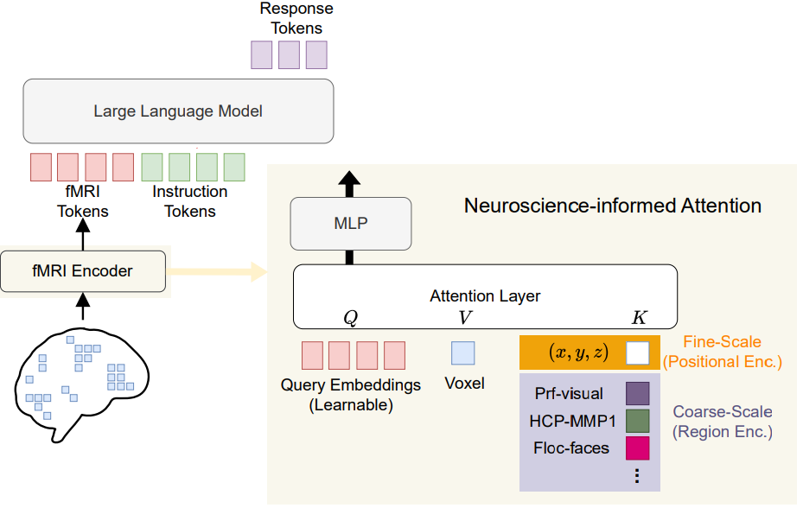
Self-Attention vs. Neuroscience-informed Attention
Notes:
These language models are trained to [Keep clicking]
predict missing words over millions of text documents.

Slide 9
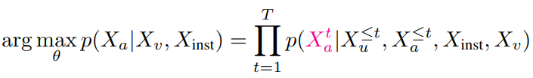
Brain Instruction-tuning (BIT)
fMRI tokens (from encoder)
+ instruction tokens ("What is in the image?")
→ into a frozen LLM (like Vicuna)
→ LLM outputs the response
How BIT is Built
Use MS-COCO Images: fMRI data is collected from subjects viewing MS-COCO images
Link image to existing datasets: Captions, Visual QA, Reasoning
Assume fMRI contains that info: If a subject saw an image that appears in these datasets, the corresponding text annotations are reasonable targets for the fMRI-to-text model.
Notes:
These language models are trained to [Keep clicking]
predict missing words over millions of text documents.

Slide 10
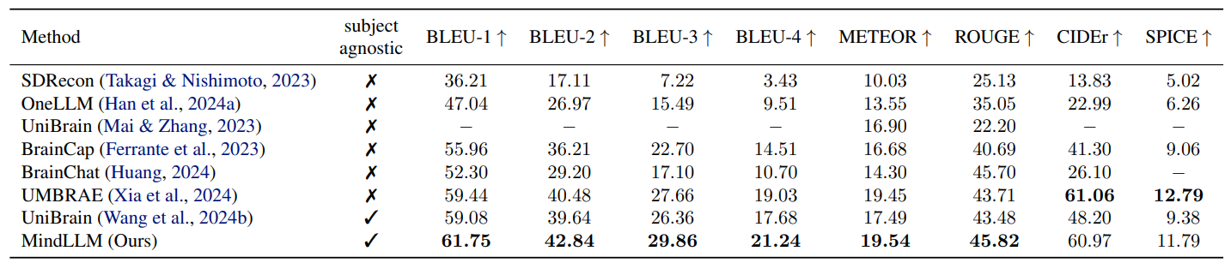
Results: Captioning Task
MindLLM outperforms baselines in terms of most metrics, with an average improvement of 3.32%

Slide 11
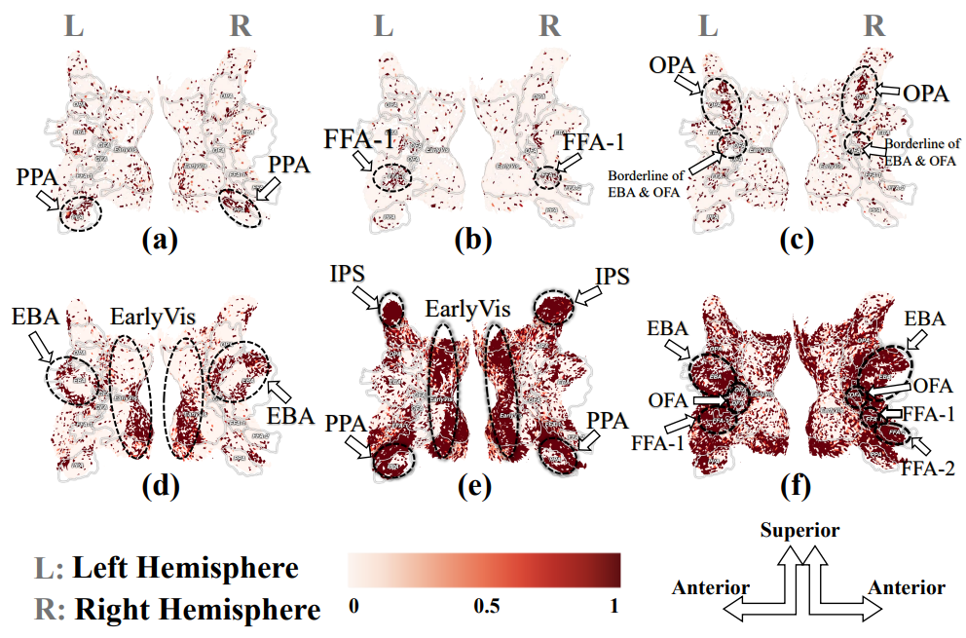
Visualizations & Interpretations
Fusiform Face Area
Parahippocampal Place Area
Early and High-visual
Learnable queries may reflect the dynamics of human brain activities in the visual task, from seeing and thinking about the image in NSD dataset
Notes:
We follow a general method used in prior works to study the alignment of representations between a LM and a human brain.
[CLICK] We provide the same chapter from a Harry Potter book to both the Language model as well as human participants.
[CLICK] For the Language model, we extract its representations at every layer for every word in the text.
[CLICK] For the human participants, we record their brain activity using Functional magnetic resonance imaging (or fMRI)
[CLICK] Next, we train a linear function that uses the extracted Language model representations to predict human brain activity
[CLICK] Finally, we test this function on unseen data, and evaluate its accuracy as the amount of “brain alignment”
[CLICK]
In summary, brain alignment of a Language model refers to how similar its representations are to a human brain’s.

Slide 12
Partial Conclusions
The neuroscienceinformed attention mechanism in the fMRI encoder ensures subject generalization, while brain instruction tuning enhances versatility
Comprehensive benchmarks demonstrate MindLLM model’s state-of-the-art performance and offer insights into the patterns it leverages.
Notes:
These language models are trained to [Keep clicking]
predict missing words over millions of text documents.

